Slide 1
Trees

Slide 2
Application Examples
Useful for locating items in a list
Used in Huffman coding algorithm
Study games like checkers and chess to determine winning strategies
Weighted trees used to model various categories of problems

Slide 3
Trees
Definition: A connected undirected graph with no simple circuits
Characteristics
- No multiple edges
- No loops

Slide 4
Example
UT Dallas
School of Engineering
School of Management
School of Social Sciences
School of Arts
CS
EE
TE
Cohort
MBA

Slide 5
Which of the following graphs are trees?
e
a
e
a
b
a
b
b
c
c
d
a
f
c
f
f
e
d
d
b
e
f
d
c
A
B
C
D
A & B : Trees
C: Not a Tree (Cycle abdcfa)
D: Not a Tree (Not connected). However it is a forest i.e. unconnected graphs

Slide 6
Tree Theorem
Theorem 1 : An undirected Graph is a tree if and only if there is a unique simple path between any two of its vertices
Proof (=>) The graph is a Tree and it does not have cycles. If there were cycles then there will be more than one simple path between two vertices. Hence, there is a unique simple path between every pair of vertices
Proof (<=) There exists a unique simple path between any pair of vertices. Therefore the graph is connected and there are no cycles in the graph. Hence, the graph is a tree

Slide 7
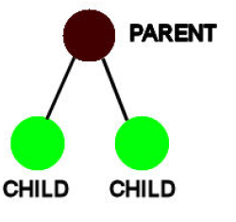
Tree terminology
Rooted tree: one vertex designated as
root and every edge directed away
Parent: u is the parent of v
iff (if and only if) there is an
edge directed from u to v
Child: v is called the child of u
Every non-root node has a unique parent (?)

Slide 8
Tree terminology
Siblings: vertices with same parent
Ancestors: all vertices on path from the root to this vertex, excluding the vertex
Descendants: Descendants of vertex v are all vertices that have v as an ancestor
Internal Nodes: Nodes that have children
External or Leaf Nodes: Nodes that have no children

Slide 9
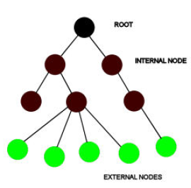
Given : Tree rooted at A
Find: Descendants (B), Ancestor (A), Siblings (G) ?
A
Root Node = A
B
Internal Nodes = B, C, E
and F
C
D
E
F
G
I
J
K
H
External Nodes = D,G, H ,I, J and K

Slide 10
Definition - Level
The level of vertex v in a rooted tree is the length of the unique path from the root to v

Slide 11
What is the level of Ted?
Lou
Hal
Max
Ed
Ken
Sue
Joe
Ted

Slide 12
Definition - Height
The height of a rooted tree is the maximum of the levels of its vertices

Slide 13
What is the height?
Lou
Hal
Max
Ed
Ken
Sue
Joe
Ted

Slide 14
Definition: m-ary trees
Rooted tree where every vertex has no more than ‘m’ children
Full m-ary if every internal vertex has exactly ‘m’ children (i.e., except leaf/external vertices).
m=2 gives a binary tree

Slide 15
Example: 3-ary tree

Slide 16
Definition: Binary Tree
Every internal vertex has a maximum of 2 children
An ordered rooted tree is a rooted tree where the children of each internal vertex are ordered.
In an ordered binary tree, the two possible children of a vertex are called the left child and the right child, if they exist.

Slide 17
An Ordered Binary Tree
Lou
Hal
Max
Ed
Ken
Sue
Joe
Ted

Slide 18
Definition: Balanced
A rooted binary tree of height h is called balanced if all its leaves are at levels h or h-1

Slide 19
Is this tree balanced?
Lou
Hal
Max
Ed
Ken
Sue
Joe
Ted

